Slide 1
lock
Joshua Satterfield

Slide 2


Slide 3
who is home?

Slide 5
AES-128

Slide 6
CBC

Slide 7
lost keys?

Slide 8

use

Slide 9
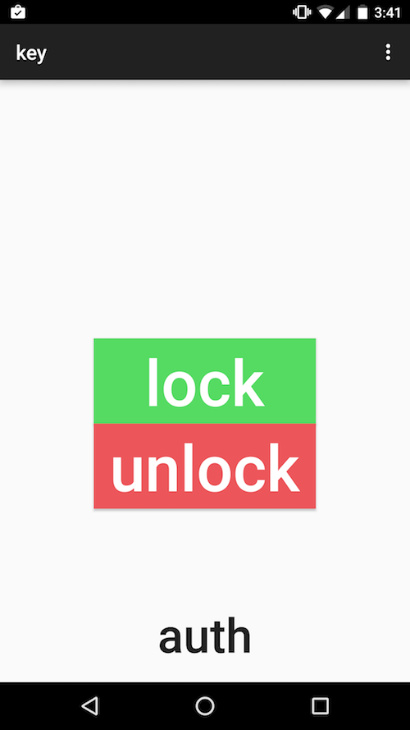

Slide 10
android& arduino.

Slide 11
customizable

Slide 12
simple protocol

Slide 13
l lock u unlock a authorize

Slide 14
lock
a
phone
1
IV 01010001
2
E(msg,
iv)
chipertext 10100100
3

Slide 15
cmd = l encrypt(msg, iv) = 00100010 decrypt(msg, iv) = l

Slide 19
?????????????????????????????????

Slide 20


